Slide 1
Dara
Creational Patterns

Slide 2
Builder
is a creational design pattern
lets you construct complex objects step by step.
allows you to produce different types and representations of an object using the same construction code.

Slide 3
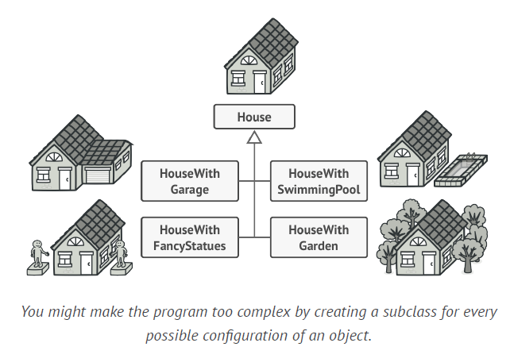
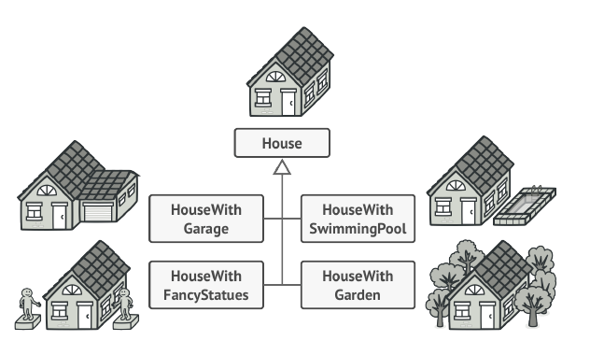

Slide 4
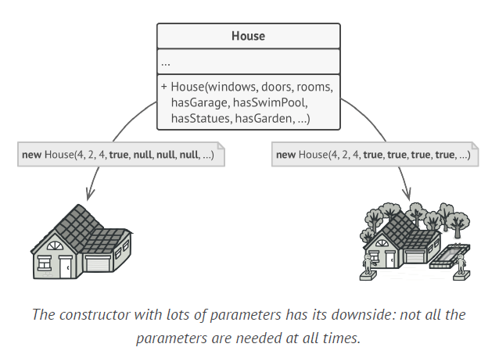

Slide 5
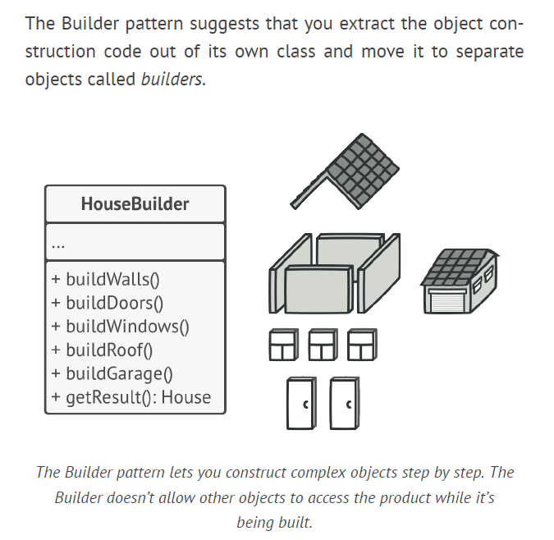

Slide 6
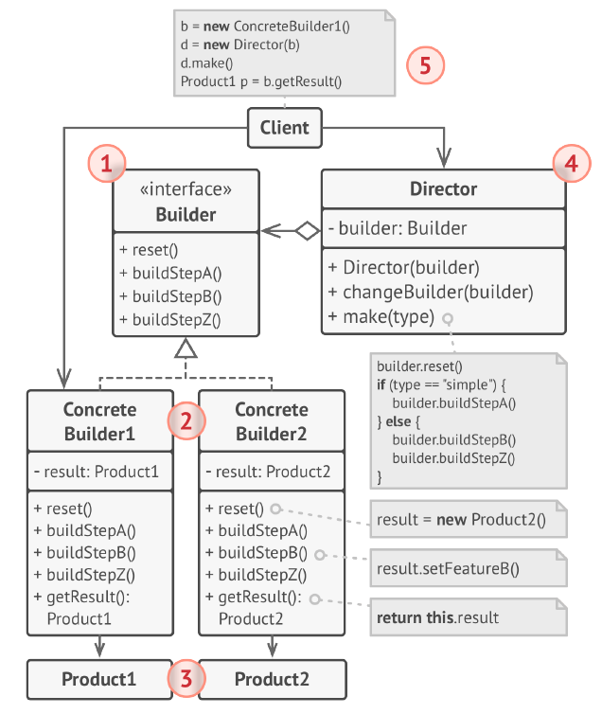

Slide 7
1.The Builder This abstract base class defines all of the steps that must be taken in order to correctly create a product. Each step is generally abstract as the actual functionality of the builder is carried out in the concrete subclasses. The GetProduct method is used to return the final product. The builder class is often replaced with a simple interface.
2. Concrete Builders There may be any number of concrete builder classes inheriting from Builder. These classes contain the functionality to create a particular complex product. Provide different implementations of the construction steps. Concrete builders may produce products that don’t follow the common interface.
3. Products are resulting objects. The product class defines the type of the complex object that is to be generated by the builder pattern.
Products constructed by different builders don’t have to belong to the same class hierarchy or interface.

Slide 8
4. The Director class controls the algorithm that generates the final product object. A director object is instantiated, and its Construct method is called. The method includes a parameter to capture the specific concrete builder object that is to be used to generate the product. The director then calls methods of the concrete builder in the correct order to generate the product object. On completion of the process, the GetProduct method of the builder object can be used to return the product.
5. The Client must associate one of the builder objects with the director. Usually, it’s done just once, via parameters of the director’s constructor. Then the director uses that builder object for all further construction.

Slide 9
Example
This pattern is used by fast food restaurants to construct children's meals. Children's meals typically consist of a main item, a side item, a drink, and a toy (e.g., a hamburger, fries, Coke, and toy dinosaur). Note that there can be variation in the content of the children's meal, but the construction process is the same. Whether a customer orders a hamburger, cheeseburger, or chicken, the process is the same.

Slide 10
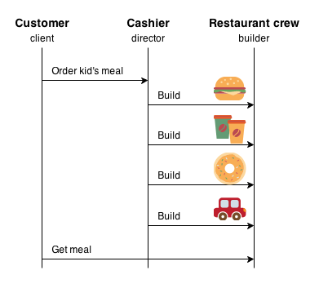
Fast food

Slide 11
Example 1
Use the Builder pattern to get rid of a “telescopic constructor”.
In this example a waiter passes a pizza order of a client. The requirement of this job is to be able to pick, build and deliver different kind of pizza.

Slide 12
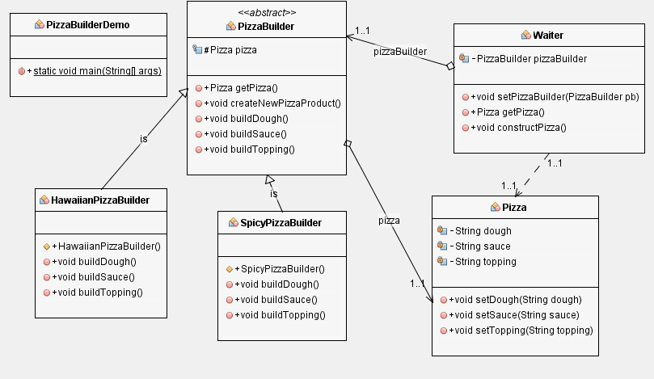

Slide 13
Advantages
You can construct objects step-by-step or run steps recursively.
You can reuse the same construction code when building various
representations of products.
Single Responsibility Principle. You can isolate complex construction
code from the business logic of the product.
Disadvantage
The overall complexity of the code increases since the pattern
requires creating multiple new classes.

